Slide 1
How to use a normalization rule in a General Publishing Profile to add a link to Primo during export
Yoel Kortick. Senior Librarian

Slide 2
Introduction
Creating the normalization rule
Using a normalization processes for import profile
Adding the normalization rule to a process
Exporting the records with the link to Primo

Slide 3
Introduction
There are cases where institutions export bibliographic records to “another” catalog and want to include a link to Primo as part of the record.
In this way the record will be imported to the external catalog and already have a link to view it in Primo.

Slide 4
Introduction
This can be done as follows:
Create a normalization rule which adds the link to Primo
Put the normalization rule in a normalization process
Option 1
Run the normalization process as part of the export
Option 2
Run the normalization process on the actual records in Alma so they include the link to Primo “always”
Export the records (which already have the link to Primo)
In this presentation we will do option 1 (we will not update the records in Alma, we will update only the exported record)

Slide 5
Creating the normalization rule

Slide 6
Creating the normalization rule
First we need to get the syntax of searching Primo for a specific record
Then we need to make the normalization rule create a field with that syntax
If you are using Primo VE then you can search for the record in Alma and select “Display in Discovery”.
If you are not using Primo VE then you can search Primo via the MMSID or other field which you will want in the link to Primo.

Slide 7
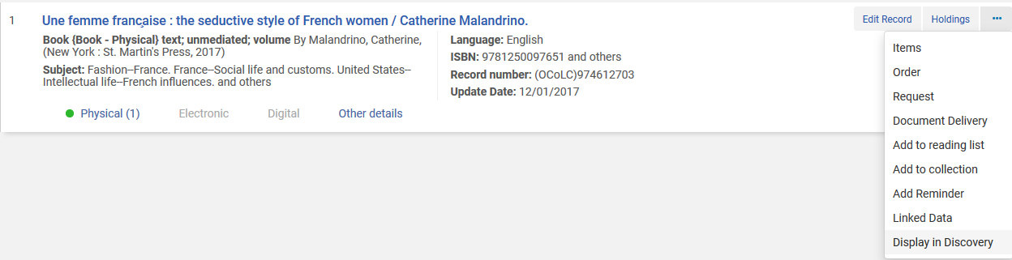
Creating the normalization rule
If you are using Primo VE then you can get the link by searching Alma for a record and choosing “Display in Discovery

Slide 8
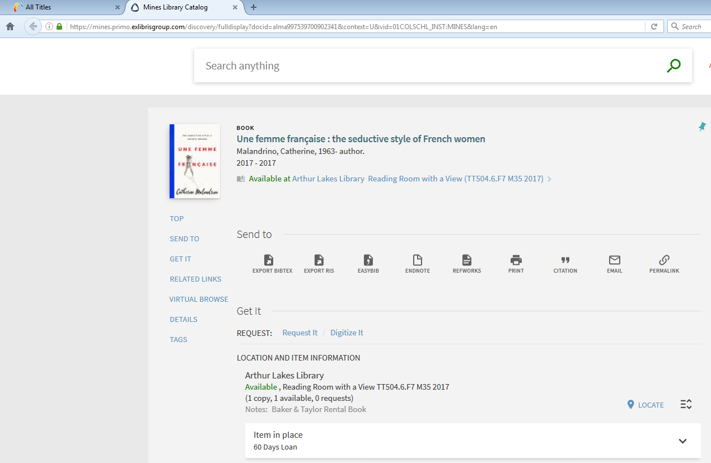
Creating the normalization rule
Now we see the URL

Slide 9
Creating the normalization rule
This is the URL (for MMSID 997520575702341):
https://mines.primo.exlibrisgroup.com/discovery/fulldisplay?docid=alma997539700902341&context=U&vid=01COLSCHL_INST:MINES&lang=en
So we need to do as follows:
Put the MMSID in the 856 u. It can be copied from 001
Prefix the MMSID with add this text:
https://mines.primo.exlibrisgroup.com/discovery/fulldisplay?docid=alma
Suffix the MMSID with this text:
&context=U&vid=01COLSCHL_INST:MINES&lang=en

Slide 10
Creating the normalization rule
When we create the 856 we will do two special operations:
At each stage we will check to be sure there is not already an 856 with the Primo URL prefix and suffix. We may be sure that our records do not already have this field, but doing the check is a way to make sure we do not have duplicate fields.
Instead of working directly on a new 856 field we will work on a temporary field and only when done with the process we will copy the temporary field to the 856. This will ensure that we will not ‘by accident’ ruin any existing 856 fields in the record which may point elsewhere. In our case the temporary field will be 956 because it is not used. The temporary field of course can be changed to a different ‘non-used’ field.
The normalization rule for this is on the next slide. Each section of the rule has a clear description so specific explanations are not needed.

Slide 11
Creating the normalization rule
rule "Copy 001 Field to 956 Field subfield u"
# Note that actions stipulated in the rule with the higher priority are performed first
priority 10
when
((not exists "856.u.https://mines.primo.exlibrisgroup.com/discovery/fulldisplay?docid=alma*") and (not exists "856.u.&context=U&vid=01COLSCHL_INST:MINES&lang=en*"))
then
copyField "001" to "956.u"
end
rule "Add the beginning of the URL to 956 u, it already has the MMSID"
priority 9
when
((not exists "856.u.https://mines.primo.exlibrisgroup.com/discovery/fulldisplay?docid=alma*") and (not exists "856.u.&context=U&vid=01COLSCHL_INST:MINES&lang=en*"))
then
prefix "956.u" with "https://mines.primo.exlibrisgroup.com/discovery/fulldisplay?docid=alma"
end
rule "Add the end of the URL to 856 u, it already has the prefix and the MMSID"
priority 8
when
((not exists "856.u.https://mines.primo.exlibrisgroup.com/discovery/fulldisplay?docid=alma*") and (not exists "856.u.&context=U&vid=01COLSCHL_INST:MINES&lang=en*"))
then
suffix "956.u" with "&context=U&vid=01COLSCHL_INST:MINES&lang=en"
end
rule "Copy the temporary 956 to 85640"
priority 7
when
((not exists "856.u.https://mines.primo.exlibrisgroup.com/discovery/fulldisplay?docid=alma*") and (not exists "856.u.&context=U&vid=01COLSCHL_INST:MINES&lang=en*"))
then
copyField "956" to "856.{4,0}"
end
rule "Remove the temporary 956"
priority 6
when
TRUE
then
removeField "956"
end
Note that if you ‘copy paste’ this rule some characters (such as quotation marks) may get distorted.

Slide 12
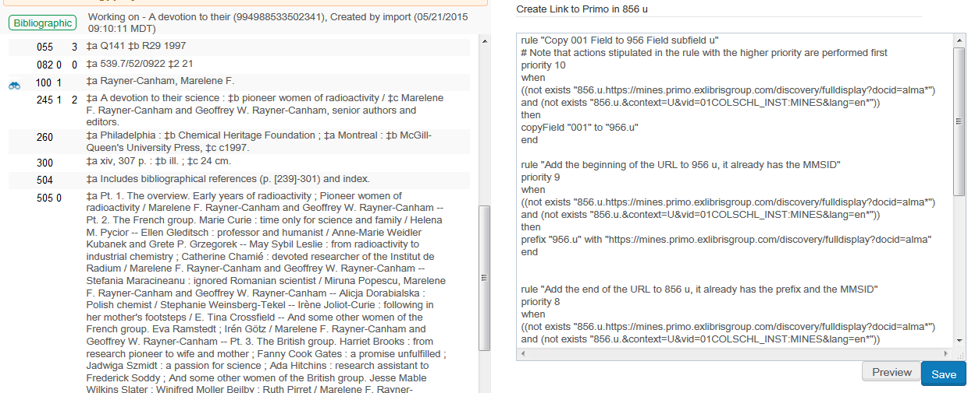
Creating the normalization rule
We can test the rule and see that it works
In the metadata editor we will click “Preview” for title “A devotion to their science: pioneer women of radioactivity”.
Normalization rule is called “Create Link to Primo in 856 u”

Slide 13
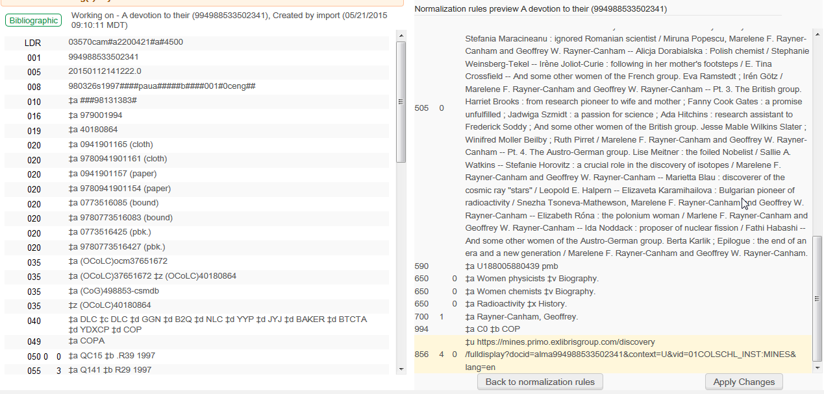
Creating the normalization rule
The 856 link to Primo was created

Slide 14
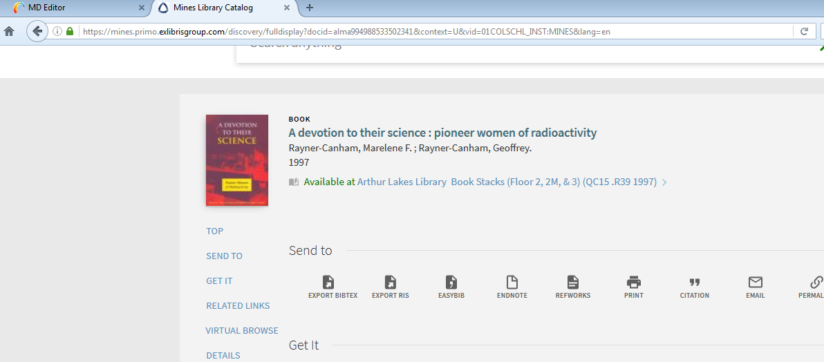
Creating the normalization rule
We can test the URL which was created by pasting it into a browser
The URL works

Slide 15
Adding the normalization rule to a process

Slide 16
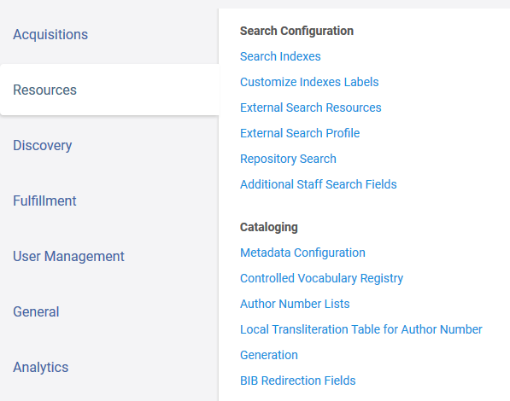
Adding the normalization rule to a process
The normalization rule we created is called “Create Link to Primo in 856 u”
Now we make a normalization process which uses this normalization rule.
Configuration > Resources > Cataloging > Metadata Configuration

Slide 17
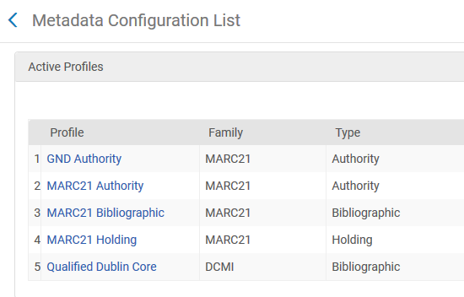
Adding the normalization rule to a process
Choose “MARC21 Bibliographic”

Slide 18
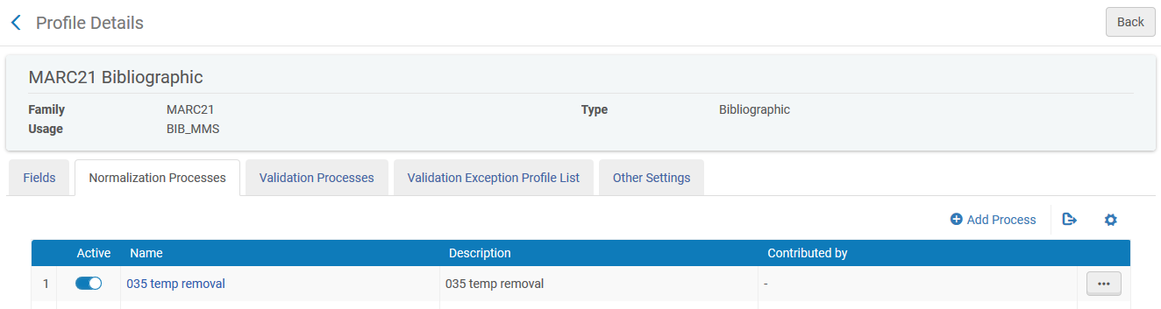
Adding the normalization rule to a process
In “Normalization Process” tab click “Add a Process”

Slide 19
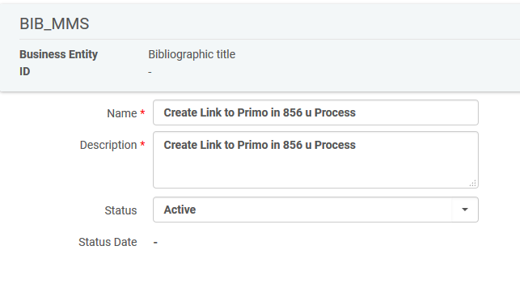
Adding the normalization rule to a process
Call the Normalization Process whatever you want and click “Next”.
Here we called it “Create Link to Primo in 856 u Process”.

Slide 20
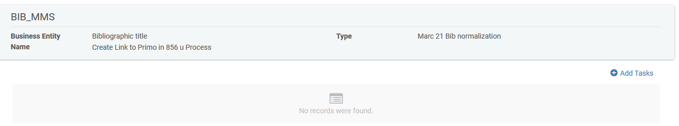
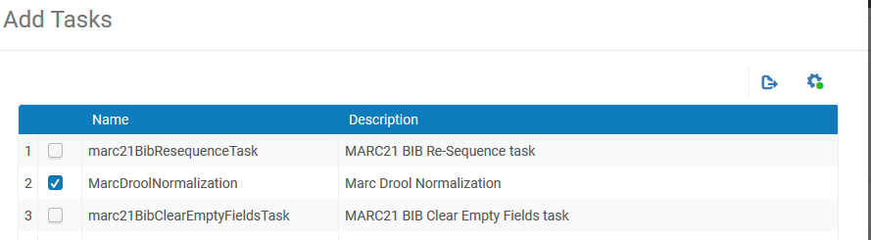
Adding the normalization rule to a process
Click “Add Tasks” and choose MarcDroolNormalization
Click “Next”

Slide 21
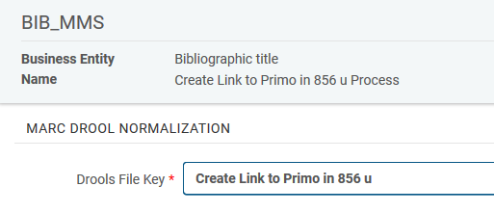
Adding the normalization rule to a process
In the “Drools File Key” field choose the Normalization Rule we already made, which is called “Create Link to Primo in 856 u”
Save the process
The process can now be used throughout the various places in Alma where normalization processes are used.

Slide 22
Exporting the records with the link to Primo

Slide 23
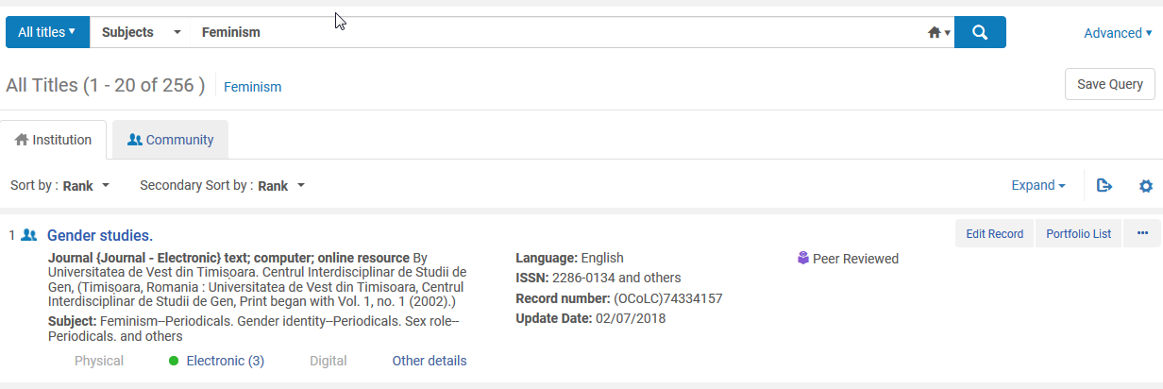
Exporting the records with the link to Primo
Create a set of all records which you want to export

Slide 24
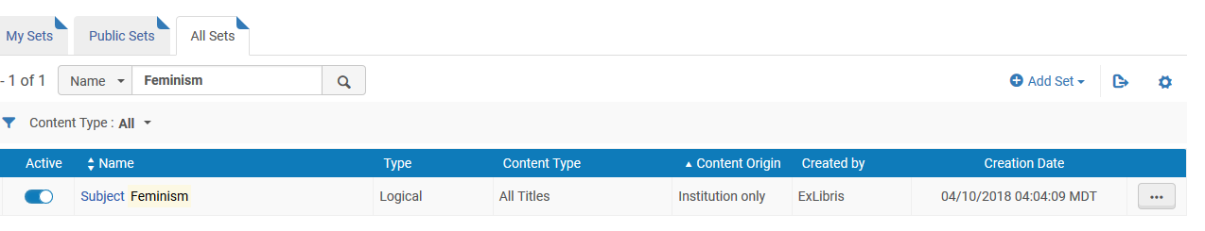
Exporting the records with the link to Primo
The set has been created

Slide 25
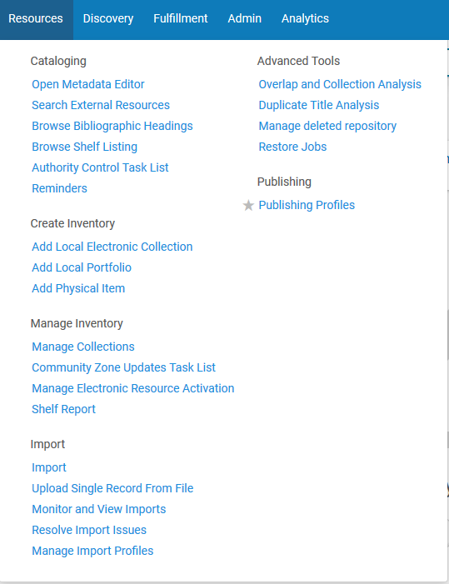
Exporting the records with the link to Primo
Create a general publishing profile which will publish this set.
Resources > Publishing > Publishing Profiles

Slide 26
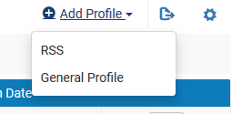
Exporting the records with the link to Primo
Add Profiles > General Profile
We will call the profile “Publish records with subject feminism and add URL link to Primo”.
It will use the set we created “Subject Feminism”
It will publish to format MARC21 Bibliographic

Slide 27
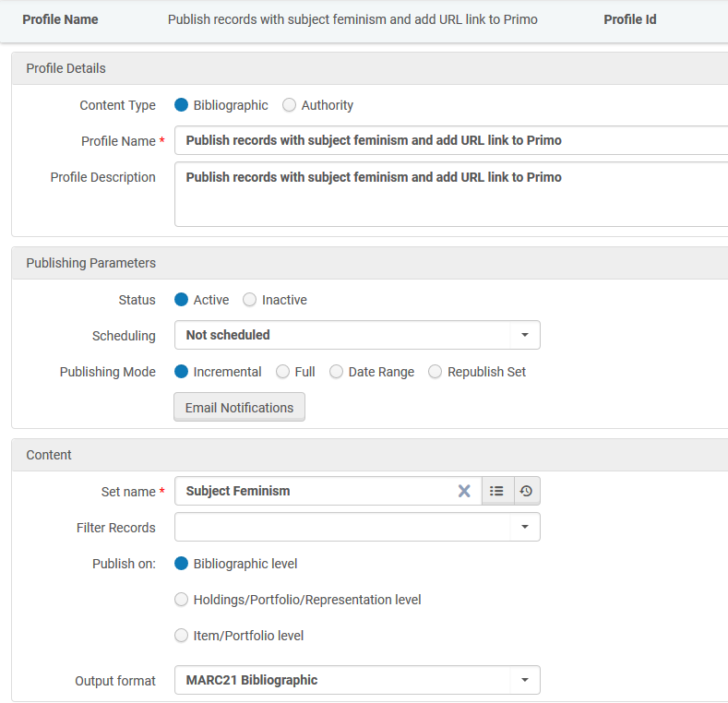
Exporting the records with the link to Primo
We have not scheduled the job. We will run it manually.

Slide 28
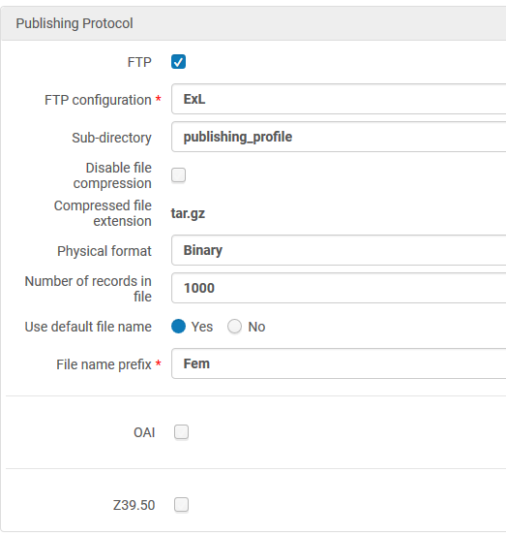
Exporting the records with the link to Primo
The file will be sent to an FTP server in MARC binary format with prefix “Fem”.

Slide 29
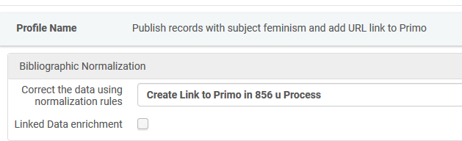
Exporting the records with the link to Primo
In the second tab of the publishing profile we have defined that the process we created to add the Primo link will be run on the records during export

Slide 30
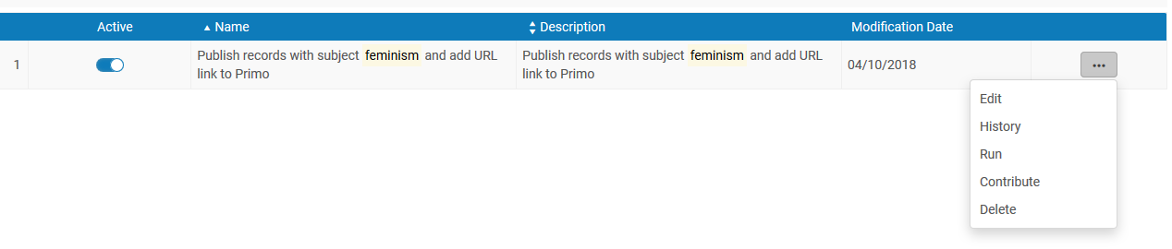
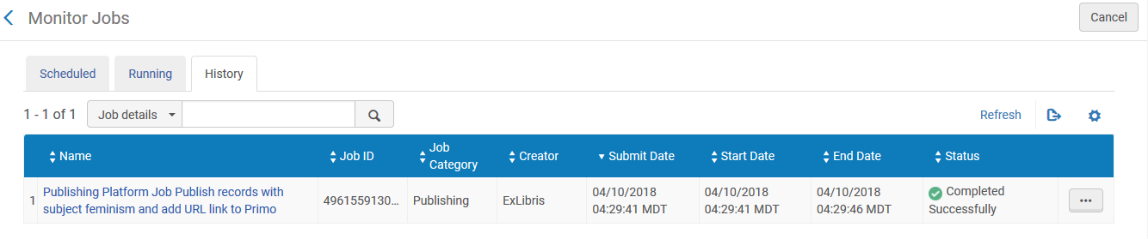
Exporting the records with the link to Primo
Run the publishing profile (we are running it manually because we did not schedule it)

Slide 31
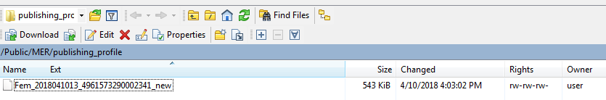
Exporting the records with the link to Primo
The file is created on the ftp server

Slide 32
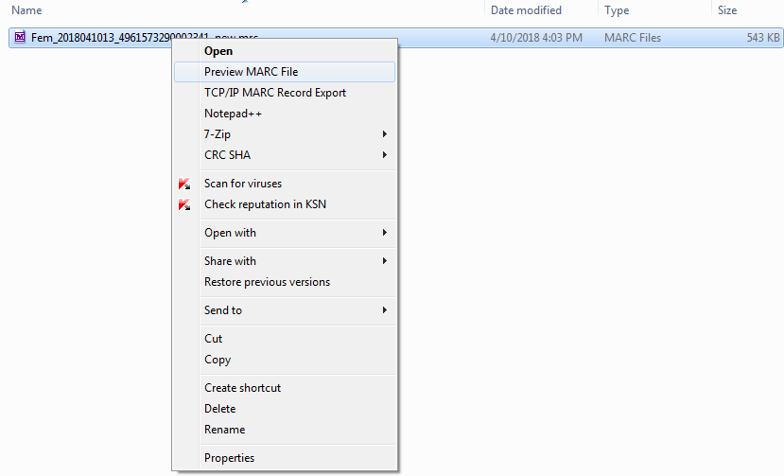
Exporting the records with the link to Primo
We will look at it in MarcBreaker format in MarcEdit

Slide 33
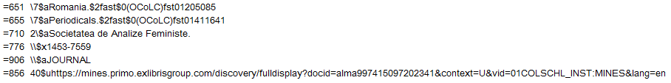
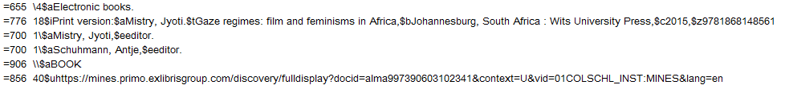
Exporting the records with the link to Primo
The URL with link to Primo has been added to all records, for example:
0

Slide 34
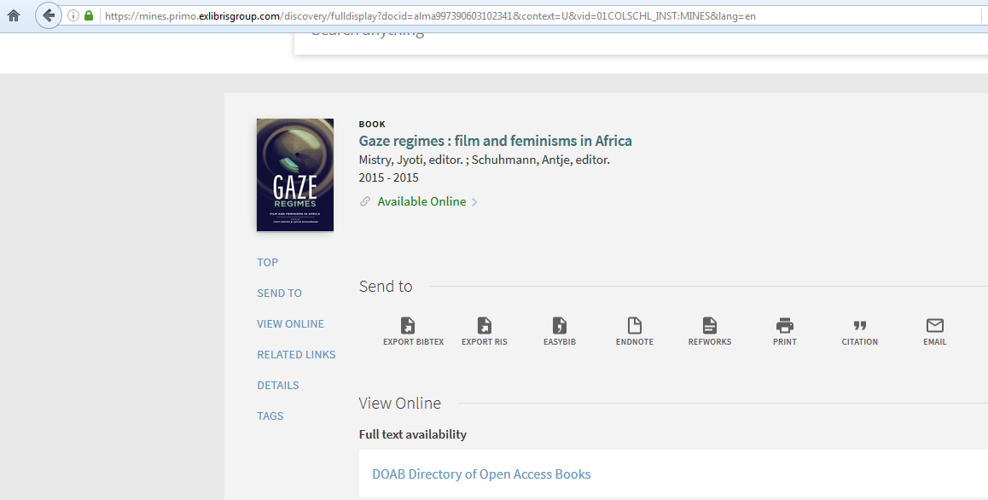
Exporting the records with the link to Primo
The URL in the 856 field is a valid URL.

Slide 35
Yoel.Kortick@exlibrisgroup.com

